Slide 1
FOOD HUT
THOUSANDS OF RESTAURANTS AT YOUR DOOR STEP

Slide 2
228 Java SL VS - RLL- Group 6
1.Gaurav Ranjan | 2528312
2.Hemalatha K | 2530722
3.Subhasree X | 2530835
4.Madhuvarshini S | 2530134
5.A Poojha | 2530427
6.Yoghashree M | 2530035
7.Sinduja Sivabalan | 2528162
8.Rajeshwari C | 2528472
9.Prasanna Santhosh Kumar | 2530009

Slide 3
ABSTRACT
1. In this project, we have created a full-stack web application called FOOD HUT, an Online Food Delivery Application.
2. We have used spring-boot for the backend, angular for the frontend, and MySQL for the database.
4. In this, users can signup/login and order food through online .
3. Admin can log in and do all the crud operations on products, customers, and purchases.
4. Cashless Transactions can be Made
5. In this Application we can Order food items of different cuisines from a restaurant

Slide 4
OBJECTIVE
1.To provide a bug-free Online Food Delivery system to Users as well as Admin.
2.The main objective is here to provide a nice and secure platform for Ordering Food.
3.To maintain the records of Product, Category available into the system

Slide 5
INTRODUCTION
Online ordering system that I am proposing here, greatly simplifies the ordering process for both the customer and the restaurant. System presents an interactive and up to-date menu with all available options in an easy to use manner.
Customer can choose one or more items to place an order which will land in the Cart. Customer can view all the order details in the cart before checking out. At the end, customer gets order confirmation details. Once the order is placed it is entered in the database and retrieved in pretty much real time.
This allows Restaurant Employees to quickly go through the orders as they are received and process all orders efficiently and effectively with minimal delays and confusion.

Slide 6
ENVIRONMENT
1.The system will be developed on any Windows OS machine using J2EE, Hibernate and Spring.
2. Intel hardware machine (PC P4-2.26 GHz, 512 MB RAM, 40 GB HDD)
3.Server – Apache Tomcat 7
4.Database – My SQL
5.Node Version 10
6.Angular
7.JDK 1.8
8.Eclipse IDE or Spring Tool Suite

Slide 7
Tools and Technologies
•Front-End: Angular
•Server-side: Spring Boot.
•Back-end: MYSQL, Hibernate.
•Server: Tomcat.
•Testing: Junit and PostMan Testing.

Slide 8

FRONT-END

Slide 9
Angular
1.Angular is a TypeScript-based free and open-source web application framework lead by the Angular Team at google and by a community of individuals and corporations. Angular is a complete rewrite from the same team that built Angular js.
2.Angular is a JavaScript (actually a TypeScript based open-source full-stack web application) framework which makes you able to create reactive Single Page Applications (SPAs). Angular is completely based on components. It consists of several components which forms a tree structure with parent and child components.
3.SPA- A single page application is a web application or a website which provides users a very fluid, reactive and fast experience similar to a desktop application. It contains menu, buttons and blocks on a single page and when a user clicks on any of them; it dynamically rewrites the current page rather than loading entire new pages from a server. That's the reason behind its reactive fast speed.

Slide 10
FEATURES OF ANGULAR
1.Cross-platform
2.Efficient MVC architecture
3.Data binding
4.Set of Directives
5.Prominence of TypeScript
6.Declarative UI
7.Extensive documentation and support
8.Timely upgradations

Slide 11
COMPONENTS BUILT USING ANGULAR
1.Home
2.Header
3.Admin login
4.Admin dashboard
5.Product
6.Cart
7.Manage customer
8.Manage purchase
9.Payment gateway
10.Order summary

Slide 12
FEATURES FOOD HUT
1.Register to the application
2.Change password
3.Update Profile
4.Sign into the application to maintain the record of activities
5.Search for food items based on the search keyword
6.Apply filters and sort results based on different cuisines to get the best deals
7.Add all the selected food items to a cart and customize the purchase at the end
8.Perform seamless payment process

Slide 13
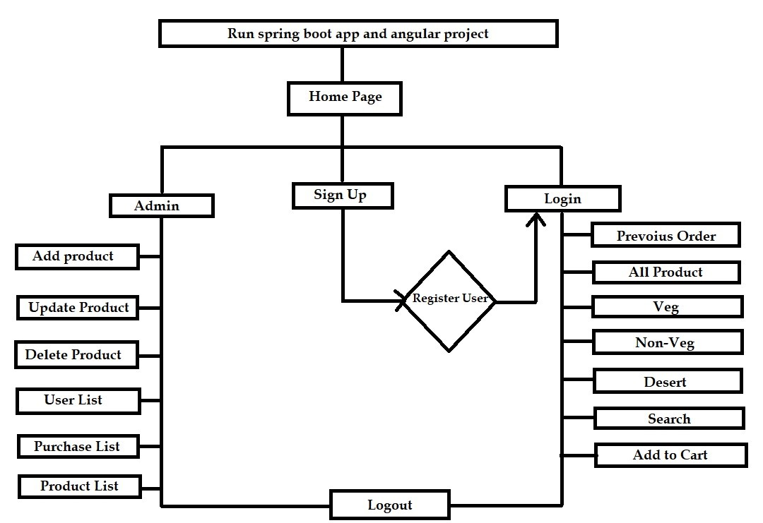
FLOW CHART

Slide 14
HOME PAGE :
Home :-
In home page User Login, Admin Login and Order Food
modules are there
Admin Login :-
Login to portal
Add or remove products.
Edit food item details.
view the Product list , Users list and Purchase list.
Below are the key responsibilities and functionalities to be implemented in the userportal.

Slide 15
User Login :-
The end user must be able to:
Register to the application
Change password
Sign into the application to maintain the record of activities
Order Food :-
Search for food items based on the search keyword.
And select a food based on category like (All products,Veg,Non-Veg,Dessert).
Add the selected food items to a cart.
FLOW:
After register successfully user can login.
After login they can find numbers of products and select the products.
Customers can see food items present in Restaurant.•
Add to cart and proceed to checkout page .
Customers can check their payment info and previous order information.

Slide 16
Admin :
1.Login to portal .
2.Create Admin Account.
3.Add or remove cuisines to or from the application to build a rich product line.
4.Edit food item details like name, price, cuisine, description, and offers to keep it aligned to current prices.
5.Enable or disable food items.

Slide 17
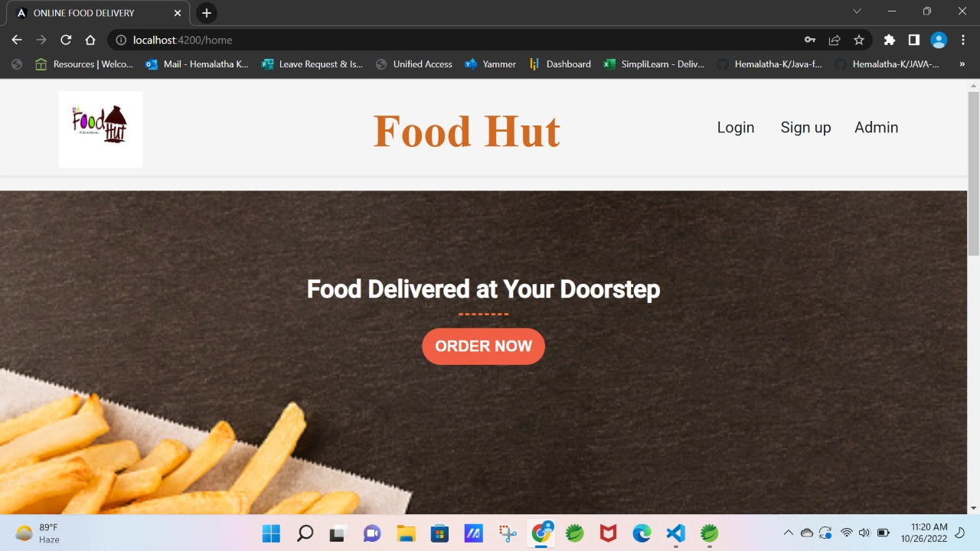
Home Page

Slide 18
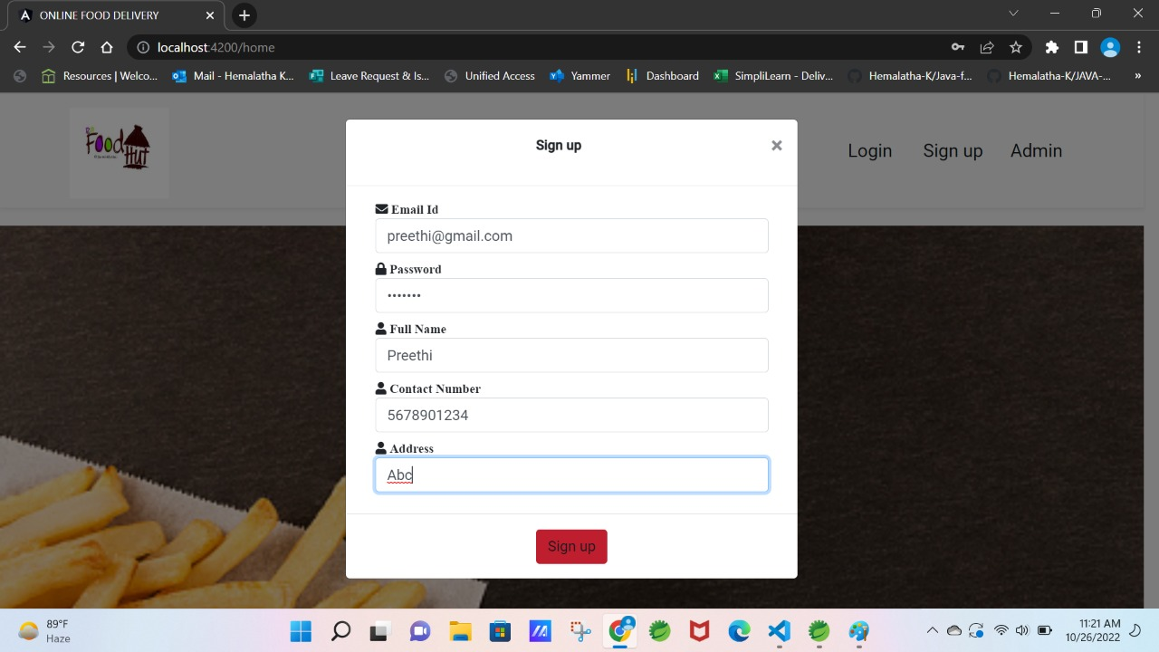
Register Page

Slide 19
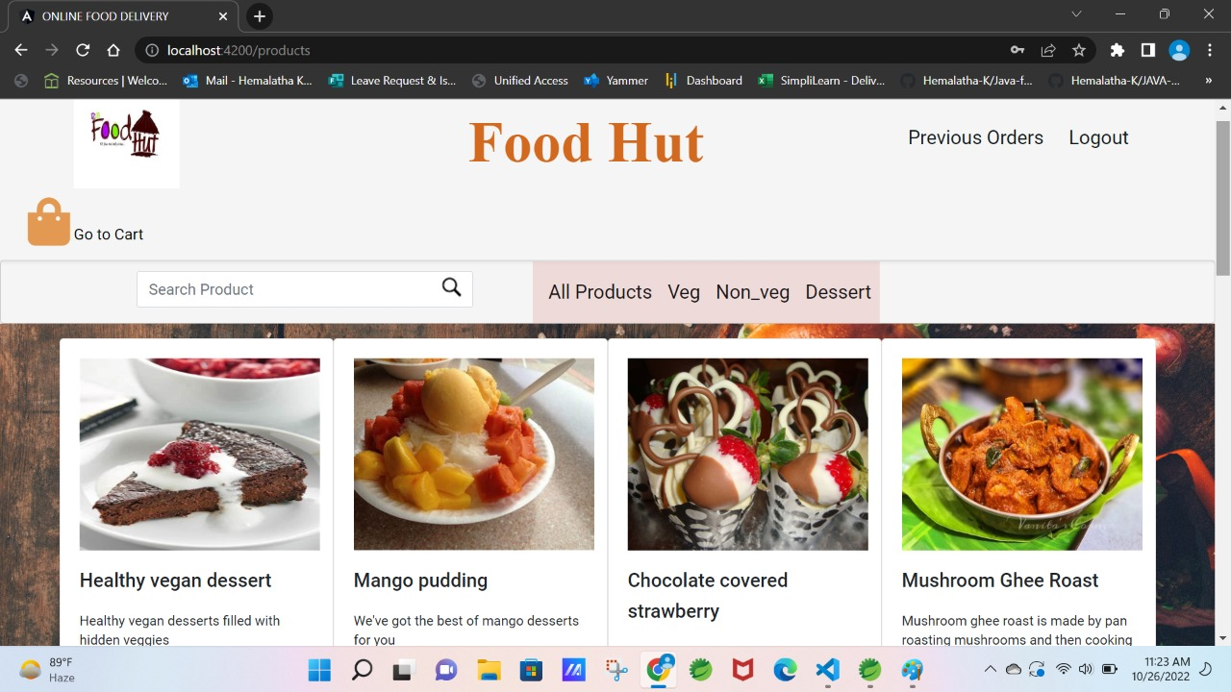
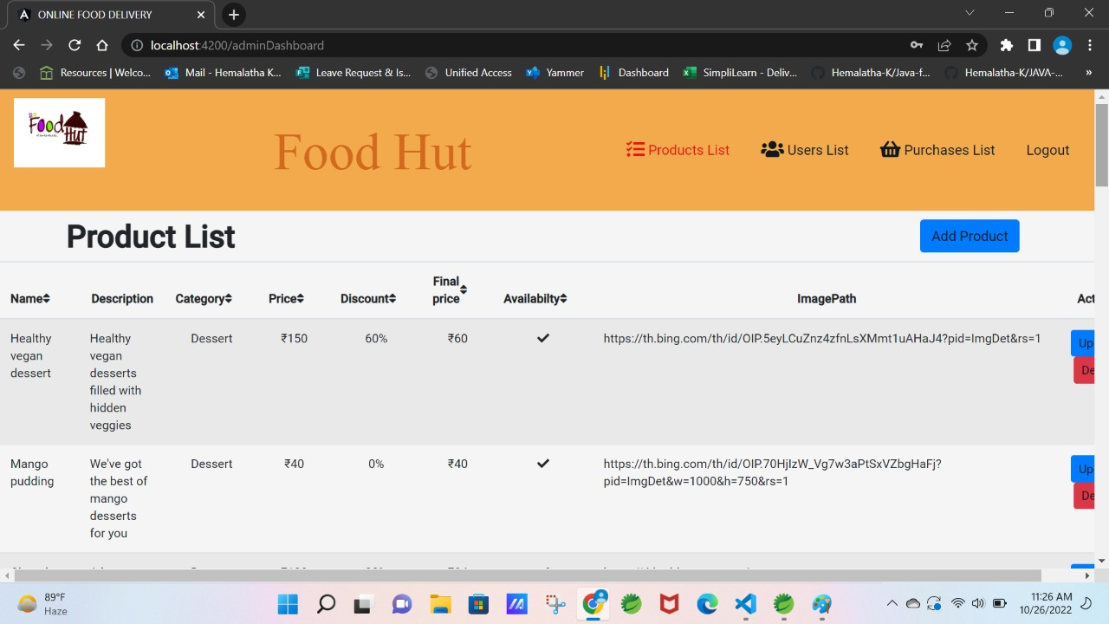
Restaurant Page
After adding products to cart

Slide 20
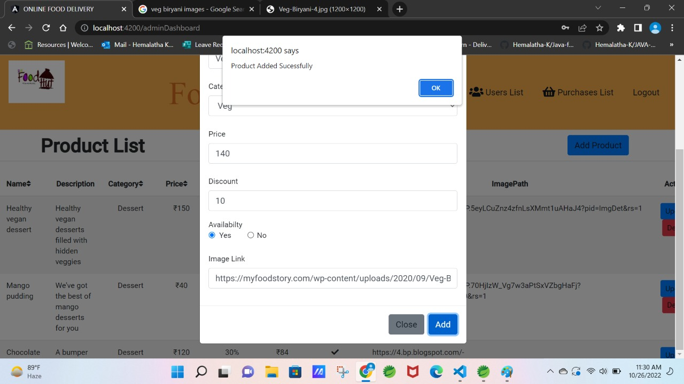
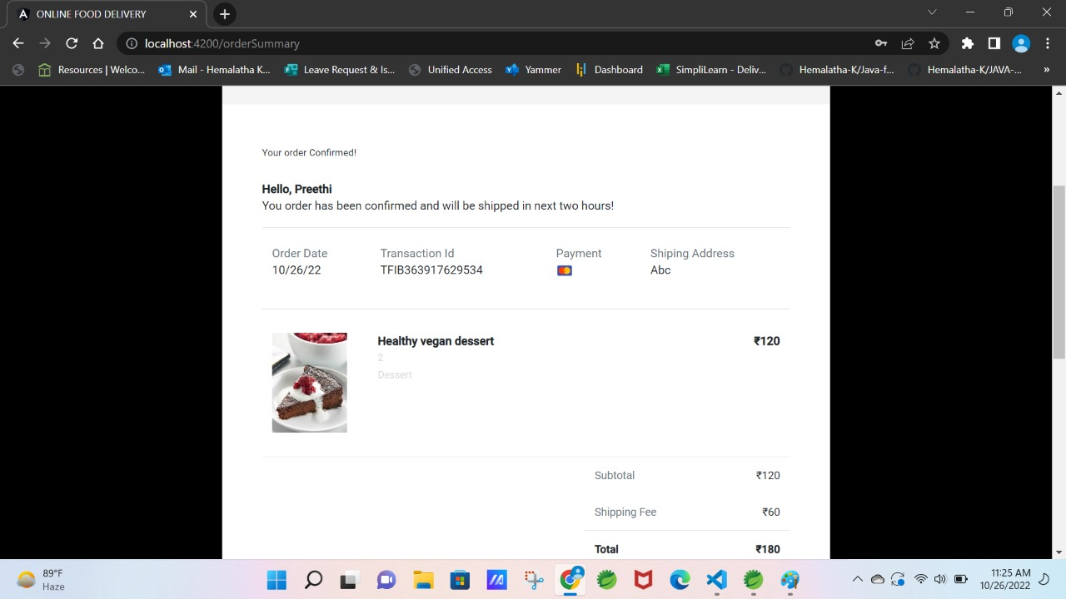
Adding products to cart
Final Billing Page

Slide 21
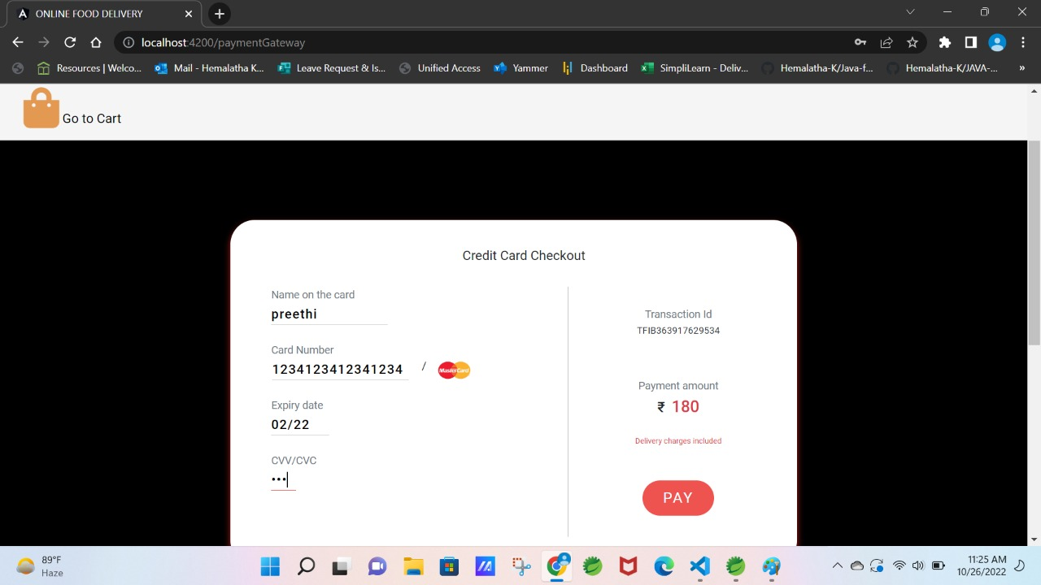
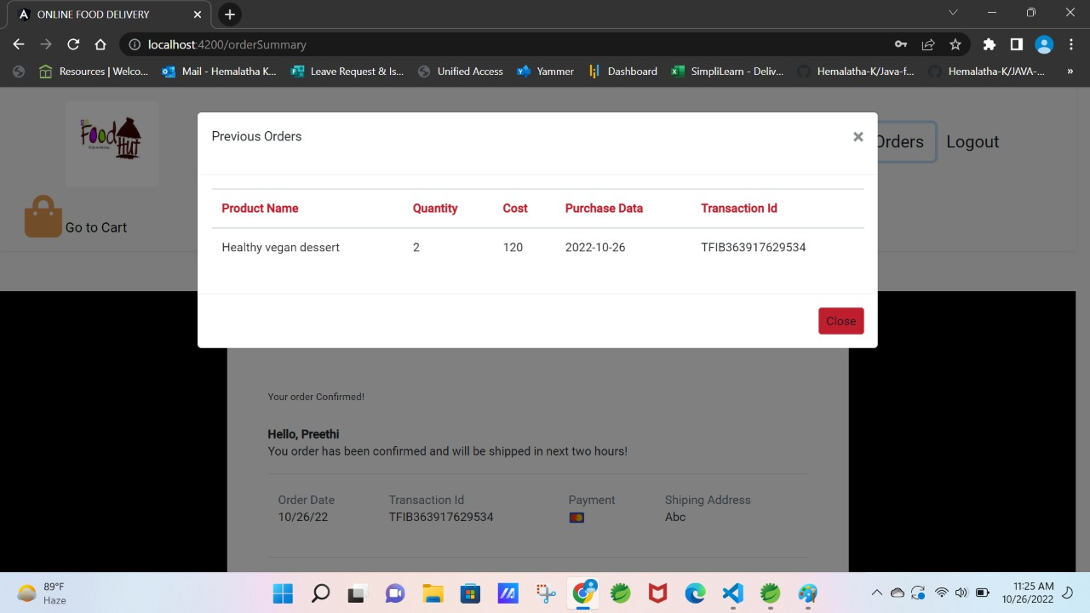
Card details
After payment order cofirmed

Slide 22
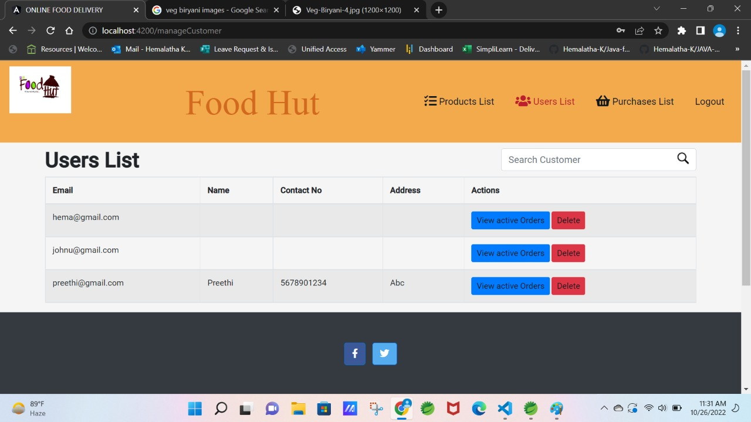
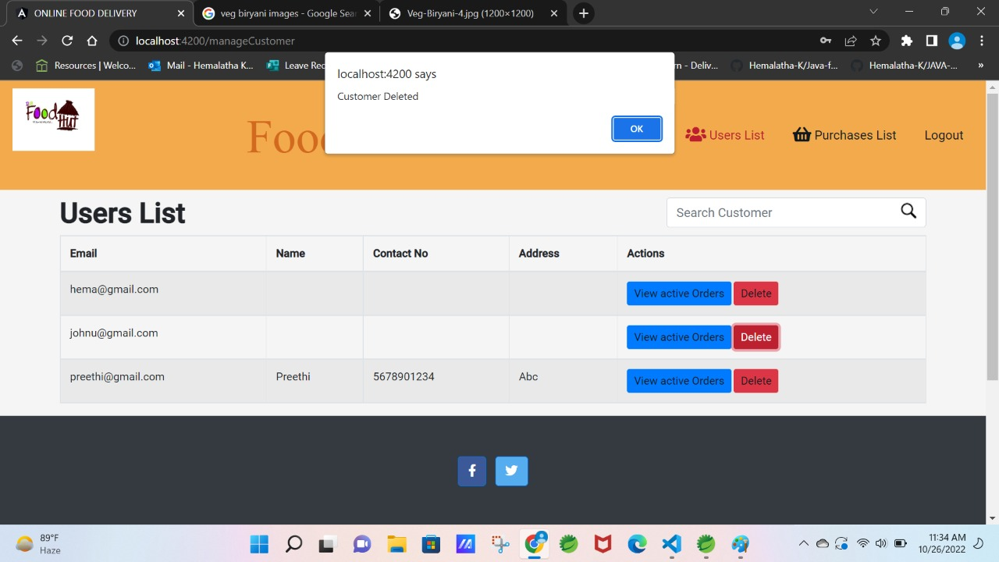
Admin Managing the customers
Admin Managing the customers

Slide 23
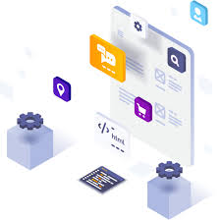
BACK-END

Slide 24
SPRING BOOT
1.Spring Boot is a Java framework, built on top of the Spring, used for developing web applications.
2.Spring Boot is a backend framework that has become a major player in the enterprise Java EE.
3.No requirement for complex XML configurations.
4.It allows you to create REST APIs with minimal configurations.

Slide 25
Steps for creating a project in Spring Boot
1.In Eclipse IDE, we have to create a new Maven Project using required Group
Id , Artifact Id ,Packaging and version.
2. In POM.xml we need dependencies such as Spring Data JPA, Spring Boot
3.Devtools, MySQL Driver and Spring web to support Spring application.
4. Later we have to configure application. properties to connect with MySQL database.
5. By creating Model, Service, Repository, Controller Packages we can perform the required Business Logics.

Slide 26
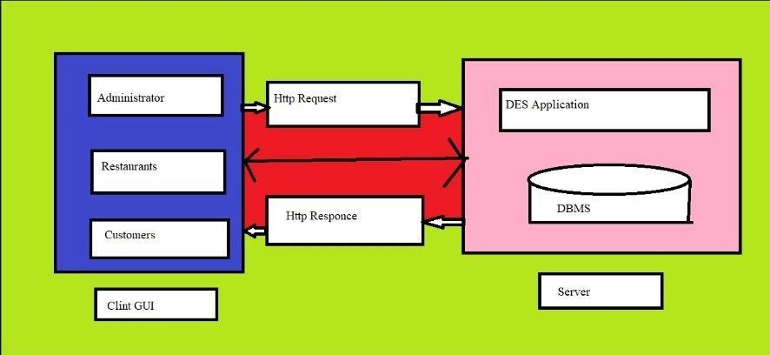
DATABASE SCHEMA DESIGN

Slide 27
REST API

Slide 28
REST API
Presentation layer(Controller):-
• Controller class which accepts the request from server and sends it to service class.
• And also gets the response from the service class of the request and sends back to server.
Service Layer:-
• This layer works on the request that is taken from the server by the controller class.
• Here the operations to be performed are created and the data required are requested from dao class.
Repository Layer:-
• The repository layer takes the request from service layer for the data to be required from database.
• And also sends it back to service layer.

Slide 29
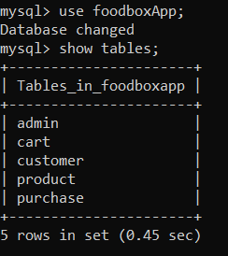
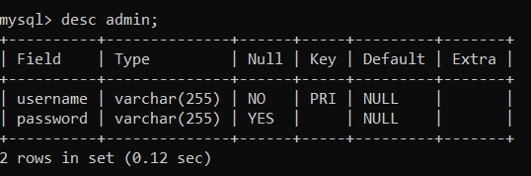
DATABASE TABLES

Slide 30
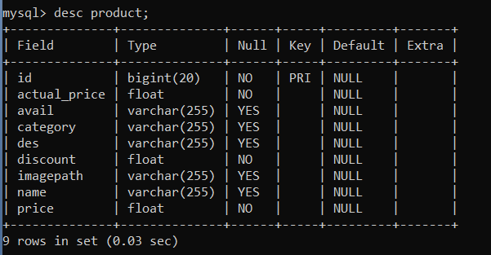
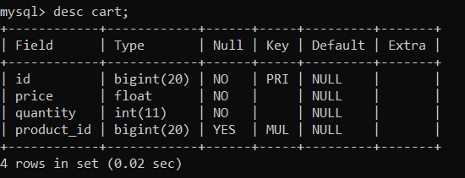
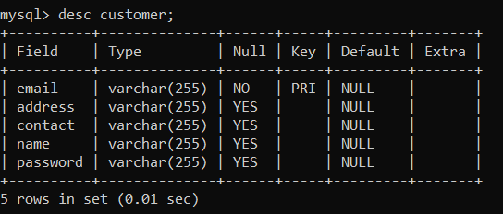
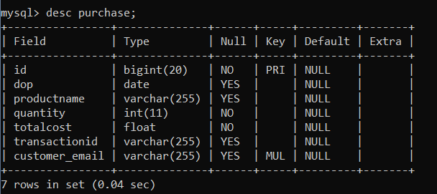
DATABASE TABLES

Slide 31
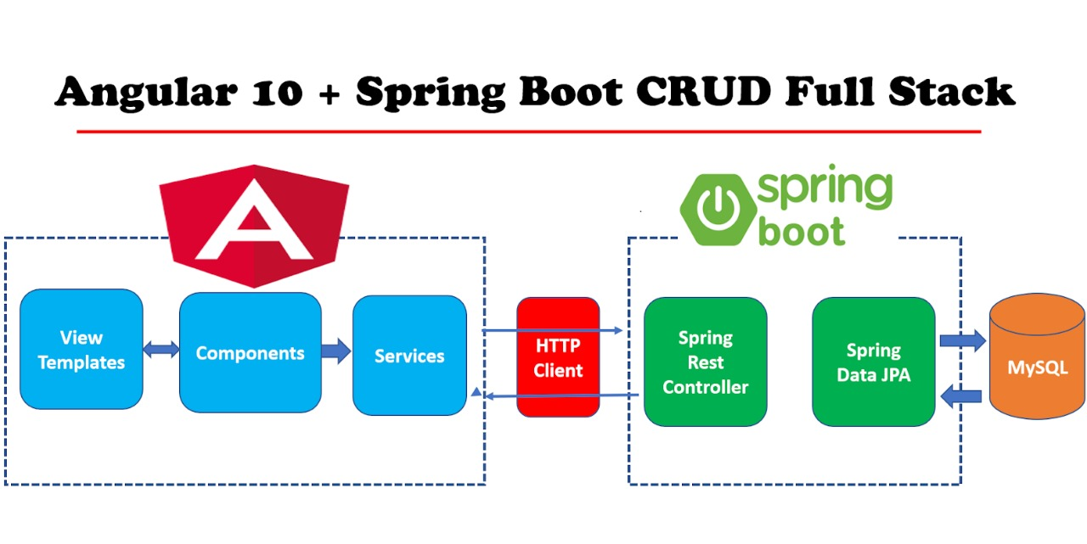
SERVER CONNECTIVITY

Slide 32
server side
Most of web applications are used Client Side Rendered, that means all the necessary codes (HTML, CSS, JavaScript and others) are make bundled together and transfer to the client browser at once.
It’s Depending on browser URL, frameworks like Angular uses that code to show (browser url) and making network requests.
Basically, In angular index.html page is served from express server for all the URL paths and that index.html page is passed through some express view engine which injects HTML into <app-root></app-root>, based on current route and component for that route.
While the Spring Boot works on the backend or the server front, the AngularJS works on the frontend and one or more web services or APIs are placed in between. The APIs act as the interface between the two, passing requests from the client in a specific format to the server and delivering the response to the client.

Slide 33
Dependencies and Annotations required
1.Spring Data JPA – Java Persistence API and Hibernate.
2.Spring Web – To include Spring MVC and embed Tomcat into your project.
3.Spring Boot DevTools – Development Tools.
4.MySQL Driver – JDBC Driver (Connecting Spring Boot to the Database)

Slide 34
Dependencies and Annotations required
1.@Autowired : To the UserRepository for dependency injection.
2.@GetMapping and @PostMapping: To specify the type of HTTP requests accepted
3.@RestController : It is a combination of @Controller and @ResponseBody
4.@RequestBody : It is used to map the body of the POST request sent to the endpoint to the User instance to save.
5.@CrossOrigin : allows a server to indicate any origins (domain, scheme, or port) other than its own from which a browser should permit loading resources

Slide 35
INTERGRATION
1.MySQL database is connected to the backend application.properties file.
2.Backend is connected to frontend through the service.ts files.
In service.ts files, httpclient url of backend is added here for integration.
class AdminService {
private baseURL="http://localhost:8080/admin"
constructor(private httpClient:HttpClient) { }
3.Similarly frontend is connected to backend through cross origin annotation.
@CrossOrigin(origins = "http://localhost:4200")

Slide 36
Application.properties
spring.datasource.driver-class-name=com.mysql.jdbc.Driver
spring.datasource.url=jdbc:mysql://localhost:3306/foodbox
spring.datasource.username=root
spring.datasource.password=root
spring.jpa.properties.hibernate.dialect = org.hibernate.dialect.MySQL5InnoDBDialect
spring.jpa.hibernate.ddl-auto = update

Slide 37
TestiNG In Spring BooT
Testing is a process that ensures the software functions without errors and fulfils the standards established by the required specification.
Spring Boot provides a variety of tools and annotations to make it simpler to test your application.
The tests are provided by two modules: spring-boot-test-autoconfigure provides test auto-configuration, and spring-boot-test contains the necessary components.

Slide 38
Types of Testing
There are two different methods of testing for our Spring Boot project.
1.Perform Unit Testing using Junit frameworks
2.Post Man Testing

Slide 39
J UNIT TESTING
The JUnit framework can be used to call a method and confirm (or assert) that the result is what you anticipated.
An annotation named @Test, which is derived from JUnit Dependency, is required for unit testing.
JUnit is a Java testing framework that makes writing reliable and efficient tests easy. It can be used for applications made in most languages but is particularly suited for testing Java applications. JUnit can also be used to create automated tests.
JUnit framework is one of the most popular Java testing frameworks. It offers several features that make writing tests easy, including support for multiple test cases, assertions, and reporting. JUnit is also versatile, allowing tests to be written in various languages.

Slide 40
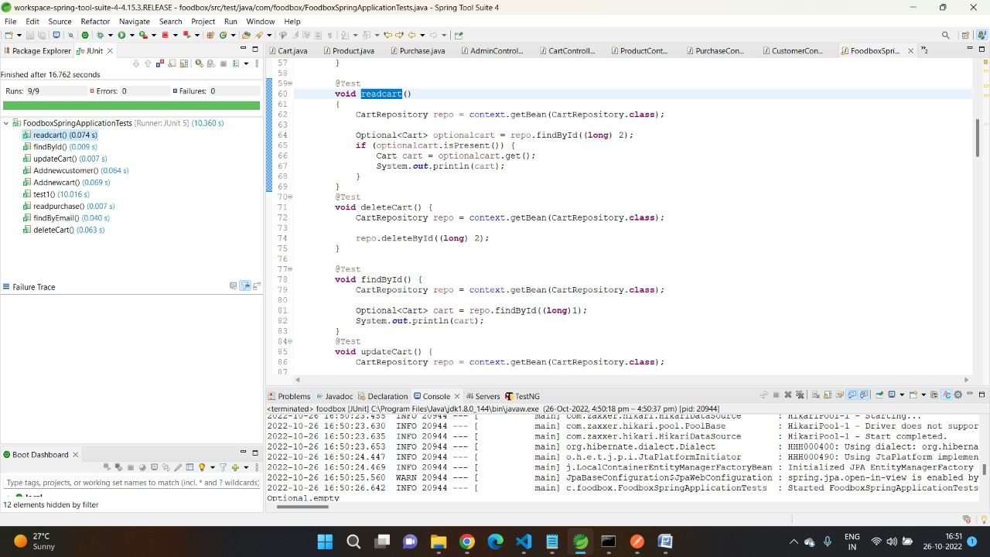

Slide 41
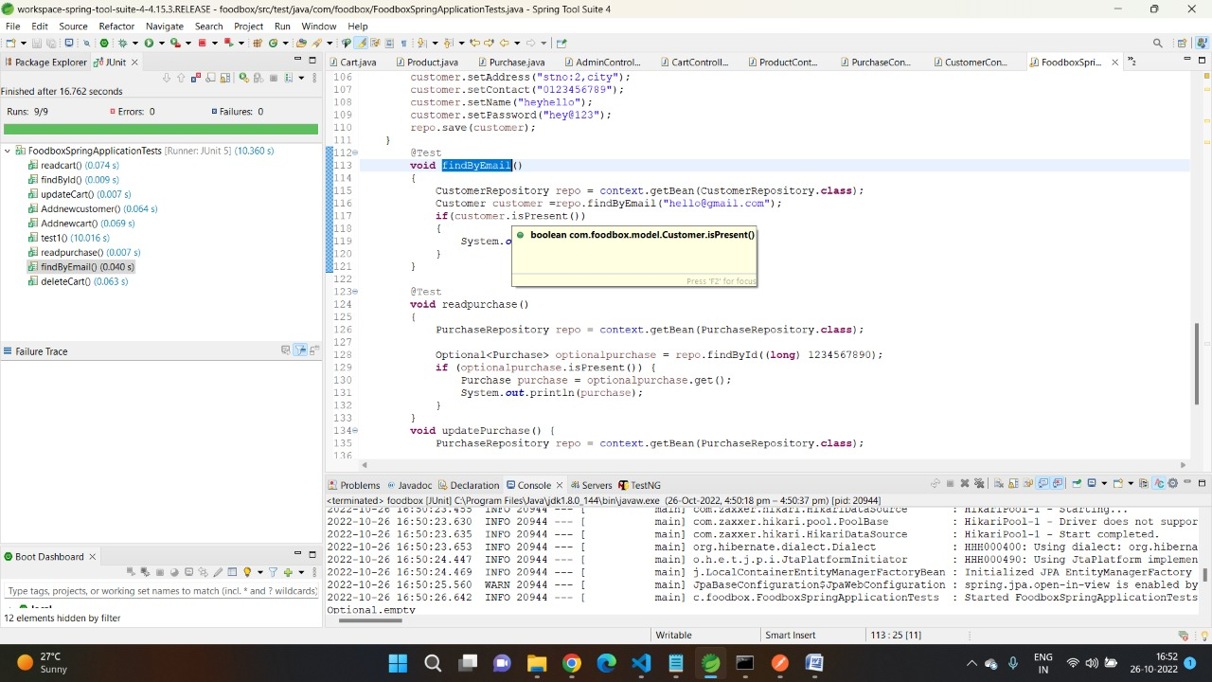

Slide 42
POST-MAN TESTING
Postman is an application used for API testing. It is an HTTP client that tests HTTP requests, utilizing a graphical user interface, through which we obtain different types of responses that need to be subsequently validated.
It is a tool for testing the software of an API. It can be used to design, document, verify, create, and change APIs. Postman has the feature of sending and observing the Hypertext Transfer Protocol (HTTP) requests and responses.

Slide 43
POST MAN TESTING URL
http://localhost:8080/carts --(Get method)
http://localhost:8080/products/cust --(Get method)
http://localhost:8080/products/{id} --(Get method)
http://localhost:8080/products/{keyword} --(Get method)
http://localhost:8080/products/{id}--(Put method)
http://localhost:8080/products/{id} --(Delete method)
http://localhost:8080/products --(Post Method)
http://localhost:8080/customers --(Get method)

Slide 44
URL | Methods | Description | Format
http://localhost:8080/products/{keyword} | Get | TO GET PRODUCT LIST USING KEYWORD | JSON
http://localhost:8080/products/{id} | Get | TO GET SPECIFIC PRODUCT | JSON
http://localhost:8080/carts | Get | TO GET CART DETAILS | JSON
http://localhost:8080/products/cus | Get | TO GET PRODUCT DETAIL | JSON
http://localhost:8080/products/45791 | put | TO UPDATE PRODUCT LIST | JSON
http://localhost:8080/products/45791 | Delete | TO DELETE SPECIFIC PRODUCTS FROM PRODUCT LIST | JSON
http://localhost:8080/products | Post | TO ADD PRODUCTS | JSON

Slide 45
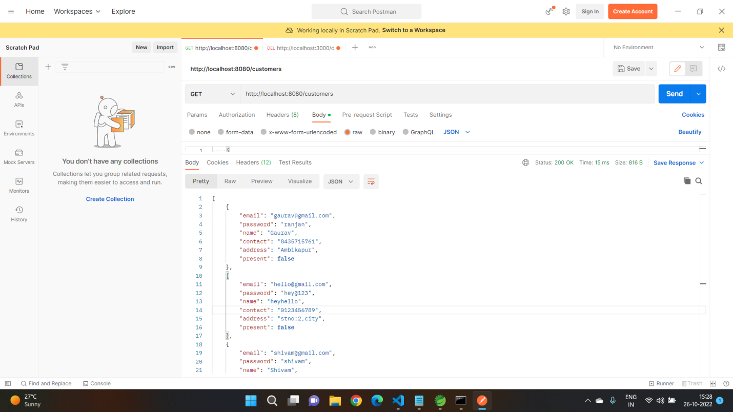

Slide 46
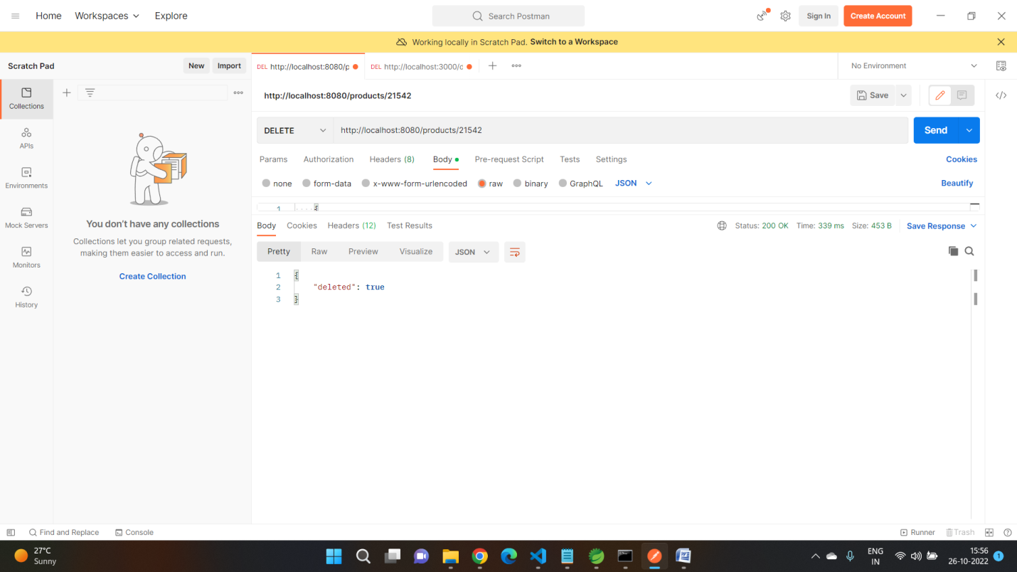

Slide 47
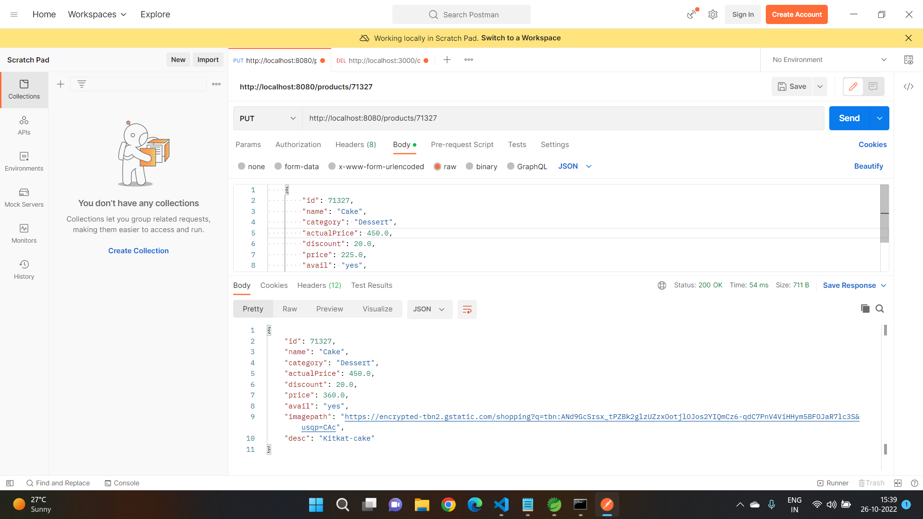

Slide 48
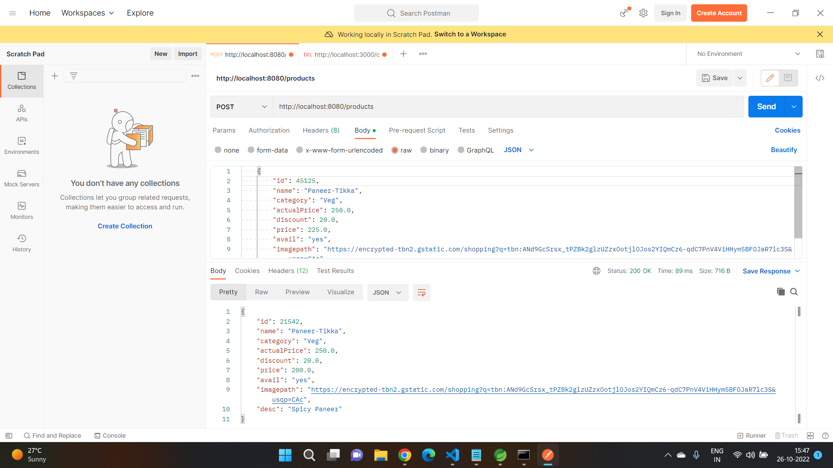

Slide 49
. .
Demonstration

Slide 50
conclusion
Finally, for the online meal ordering system, we created a secure, user-friendly food ordering administration system.
Whether they are Administrators or Customers, this system can look after them all.
This system will let them manage client meals, delivery boy data, and expand without creating any disruption.
This system is completely secure because each user is assigned a unique user ID and password, preventing unauthorised access.
With online payment, registration, and cancellation, it's a lot easier to use.
As a result, using this strategy will help to minimise labour expenses while also giving clients more opportunity to enjoy the services.

